Slide 1
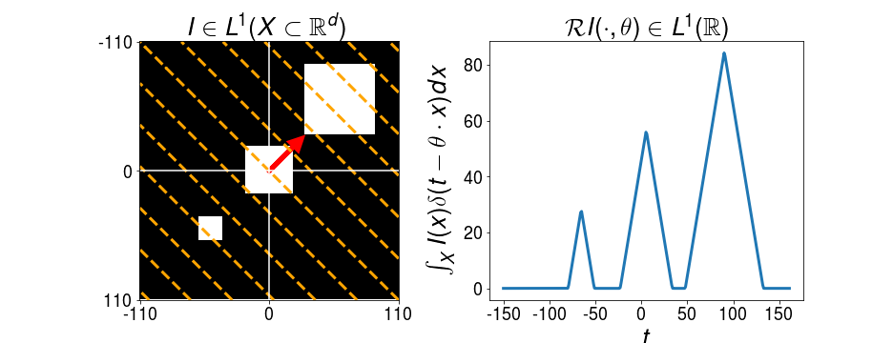
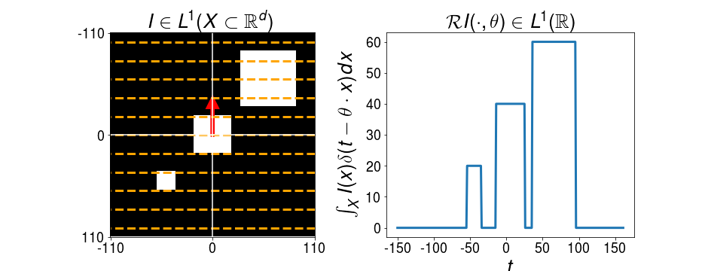
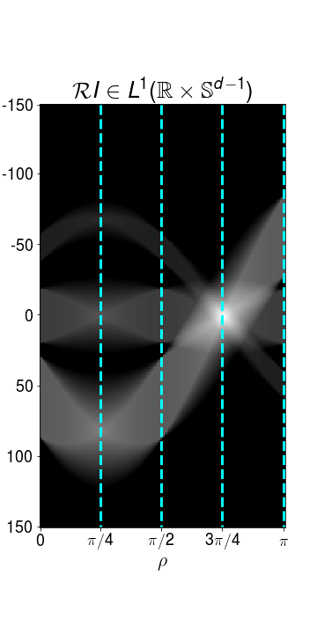
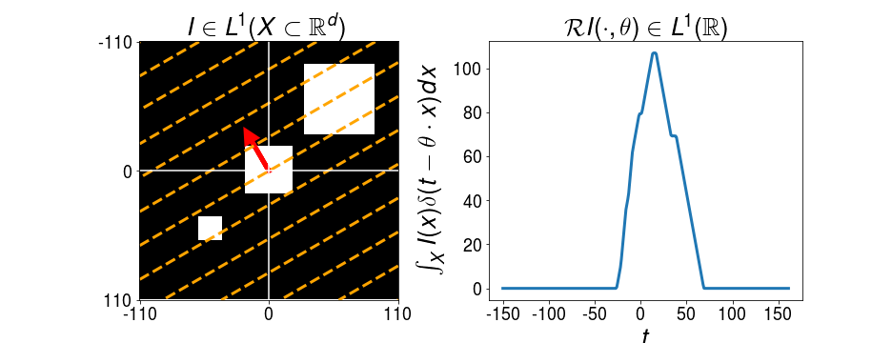
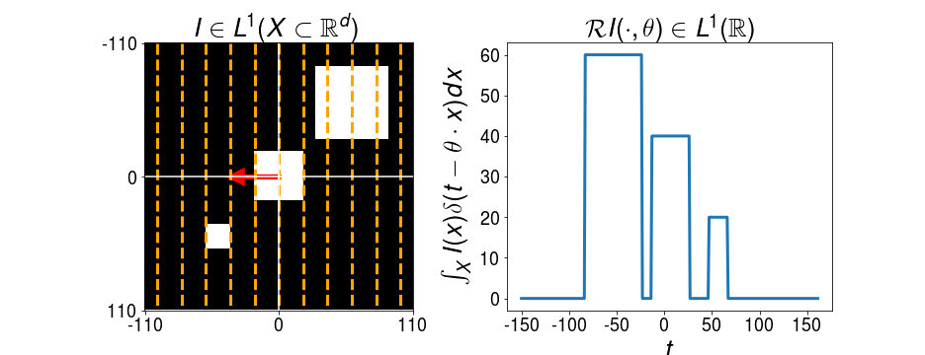




$$ρ=π/4$$
$$ρ=π/2$$
$$θ={\left[\cos\left(ρ\right),\sin\left(ρ\right)\right]}^{T}$$
$$ρ=3π/4$$
$$ρ=π$$
(a)
(b)

Slide 2
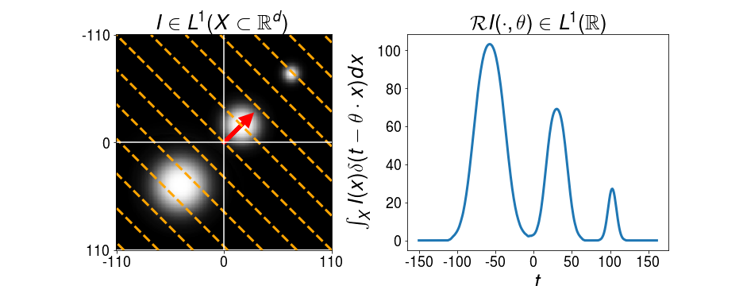
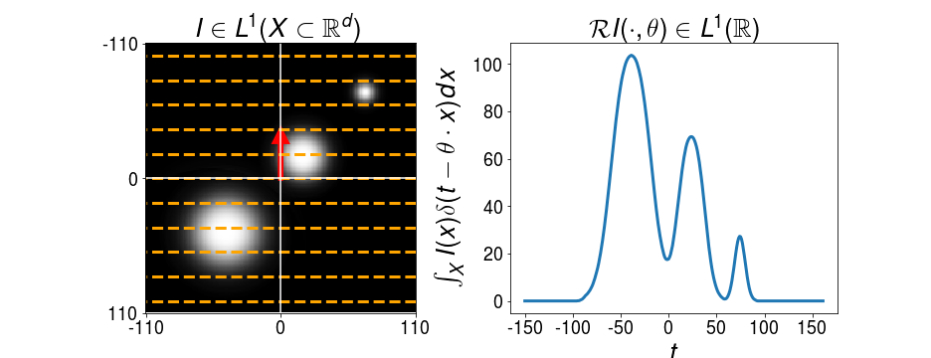
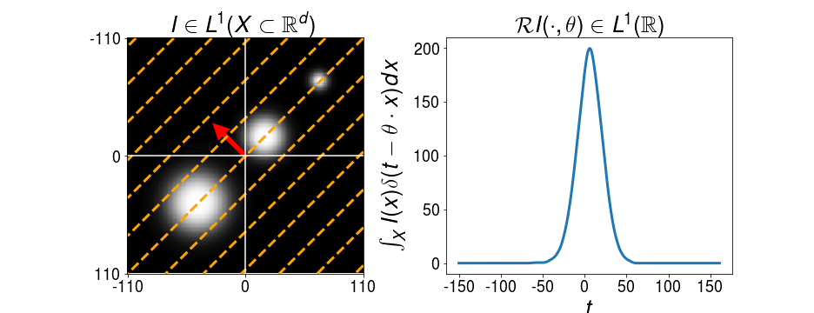
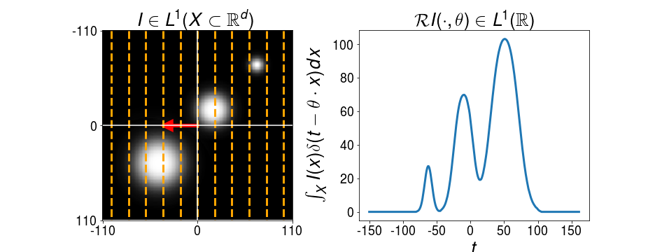



$$ρ=π/4$$
$$ρ=π/2$$
$$θ={\left[\cos\left(ρ\right),\sin\left(ρ\right)\right]}^{T}$$
$$ρ=3π/4$$
$$ρ=π$$
(a)
(b)

Slide 4





Nonlinearity
Leaky-ReLU
Linear Slices
$${∗α}_{1}$$
Integration Along Hypersurfaces
$${∗α}_{2}$$
Final Generalized Slice
$${∗α}_{3}$$
$${∗α}_{4}$$
$${∗α}_{5}$$

Slide 5
Nonlinearity
Sigmoid
Linear Slices
$${∗α}_{1}$$
Integration Along Hypersurfaces
$${∗α}_{2}$$
Final Generalized Slice
$${∗α}_{3}$$
$${∗α}_{4}$$
$${∗α}_{5}$$

Slide 6


Nonlinearity
Sigmoid
Max
Pooling
Linear Slices
Integration Along Hypersurfaces
$${∗α}_{1}$$
Final Generalized Slice
$${∗α}_{2}$$

